Slide 1

Trending Video Analysis
Group Name: Happy Data Programming
Members: Wei Zhang, Wanyi Su, Zeyu Hu, Jinyao Lu, Yin Yu Kevani Chow
Apr 9, 2022
Notes:
Welcome to our youtube trending video analysis.

Slide 2








Motivation
Why is it an important project?
2.3 Billions Users
1st Video Sharing Platform 2nd Largest Search Engine 2nd Most Popular Platform for Influencer Marketing
197 Millions
Digital Marketing
YouTuber Annual Revenue
50 Millions
US$237.15 millions
US$29.5 Millions
18 Millions
Statistic Reference https://www.globalmediainsight.com/blog/youtube-users-statistics/ | https://cybercrew.uk/blog/youtube-usage-statistics-uk/ | https://biteable.com/blog/video-marketing-statistics/
Notes:
Recently, many companies choose YouTube as important digital marketing platform. What are the elements to be listed on YouTube trending videos so they can reach as many people as possible? By solving this, business can invest wisely on specific YouTube Videos by product placement as well as YouTuber can use a more systematic way for their content creation. Thus, this is our project focus.

Slide 3
Dataset
Previous
YOUTUBE DATA FROM Kaggle
DAILY YOUTUBE API
1 JAN 2021 to 6 APR 2022
281,338 Records
Eastern Time Zone
Eastern Time Zone
Greenwich Mean Time
Notes:
We have combine the pervious youtube dataset from kaggle and run API to get daily youtube trending list data including the US, Canada and Great Britain from recent years.
The publish date time is converted to the corresponding time-zone.

Slide 4
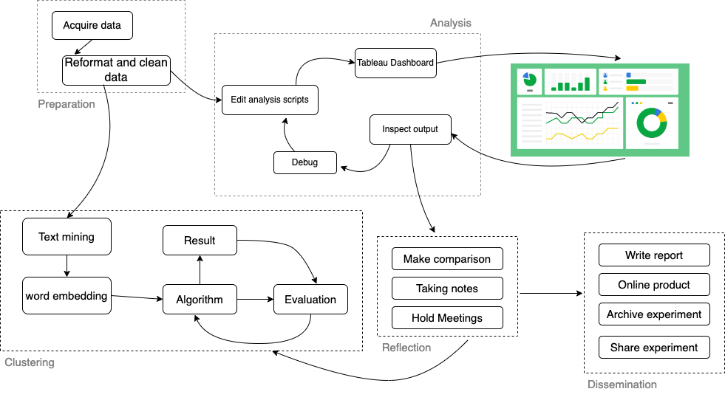
Data Science Workflow
Notes:
We have 5 main phases for workflow:
First is Preparation of the data, then alternating between the second and third phases, Which are analysis and modeling.
The 4th part is Reflection to interpret the outputs, and finally Dissemination of results in the form of written reports, executable code and online product.

Slide 5
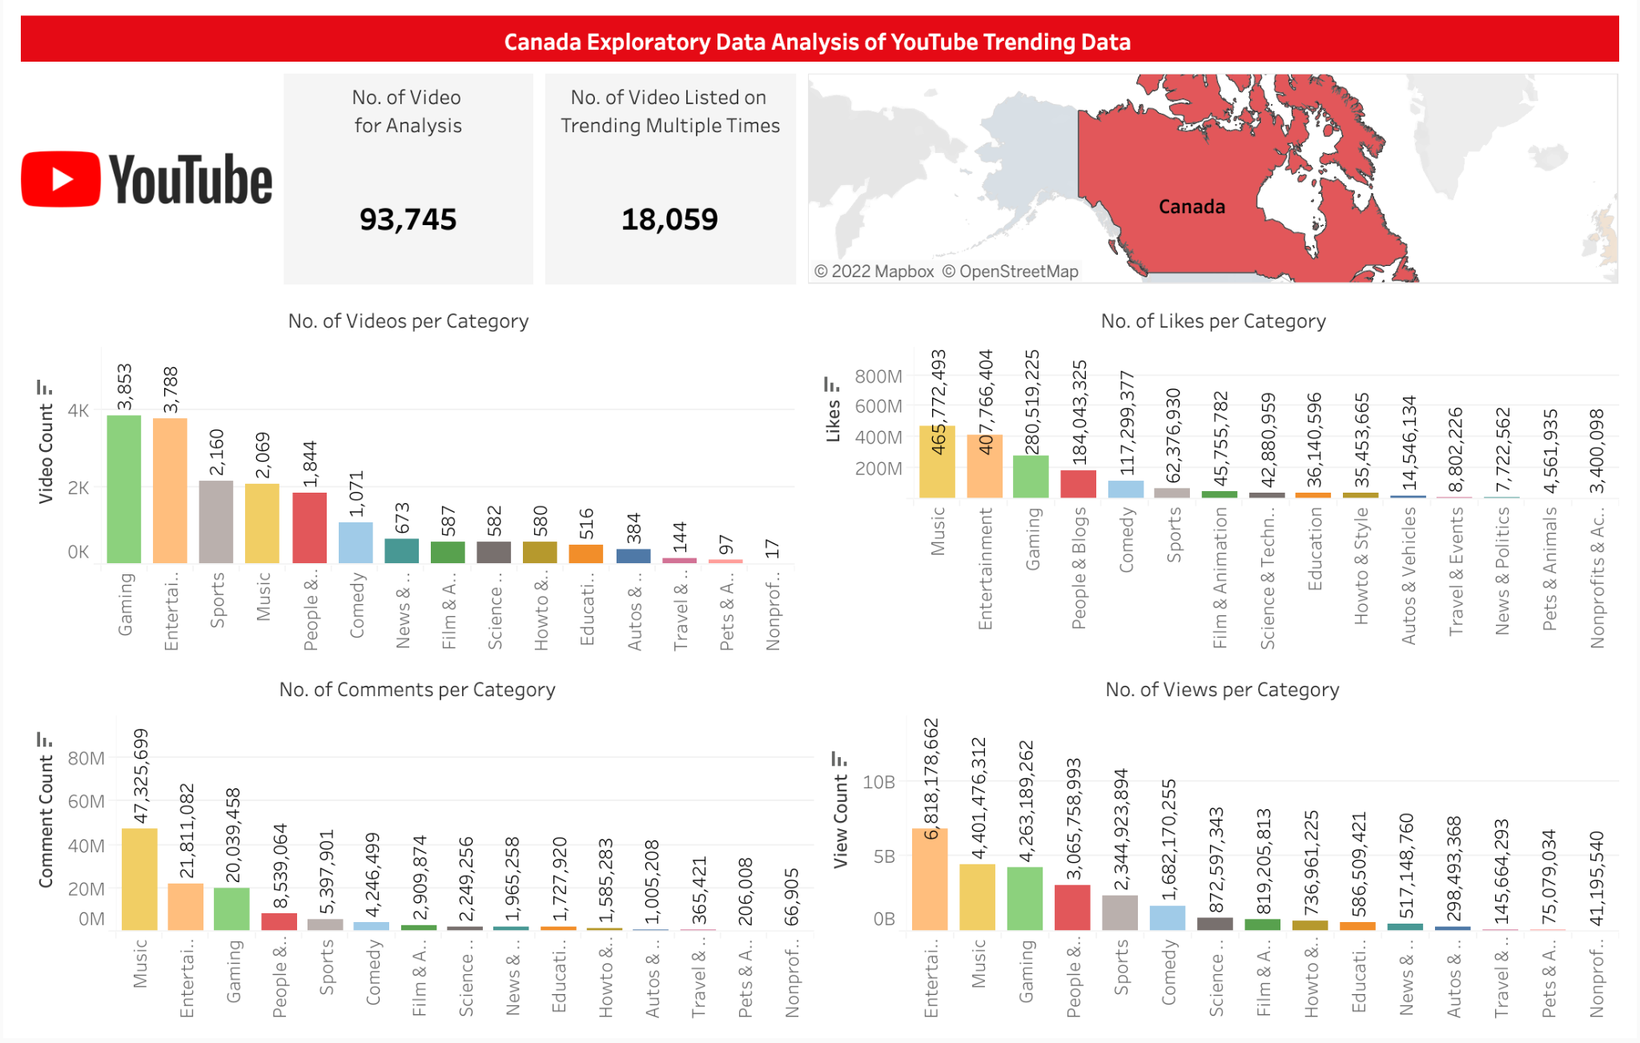
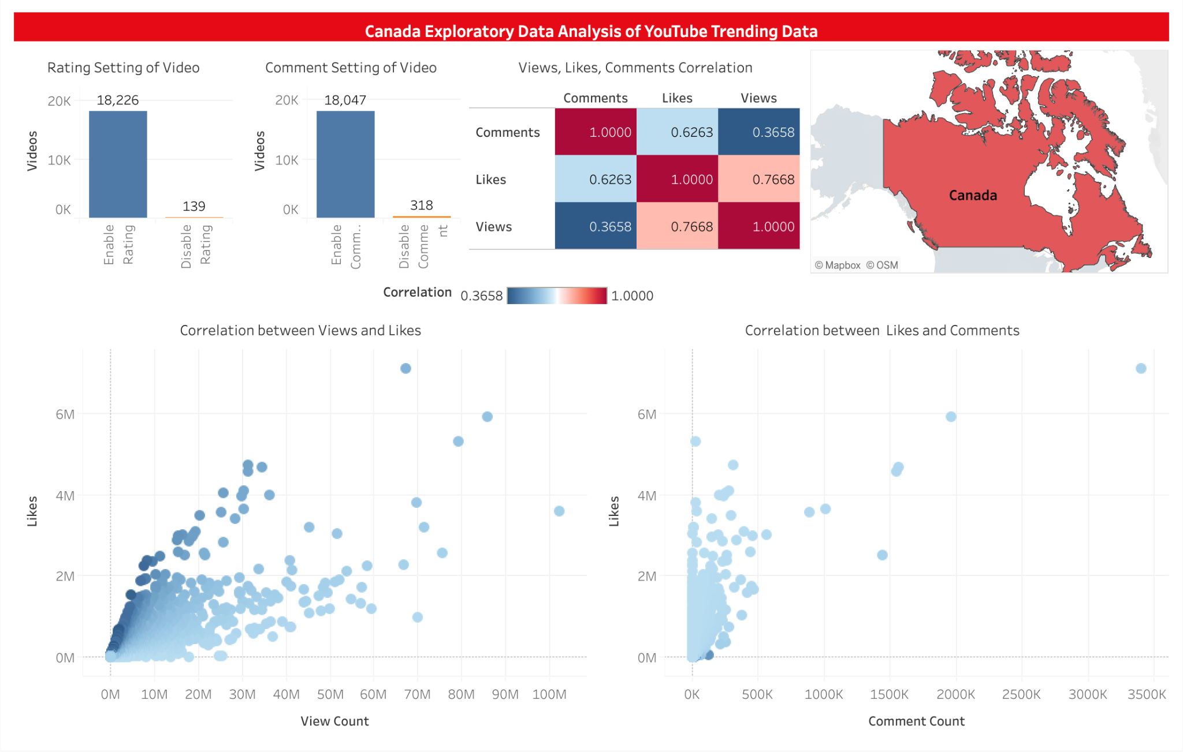
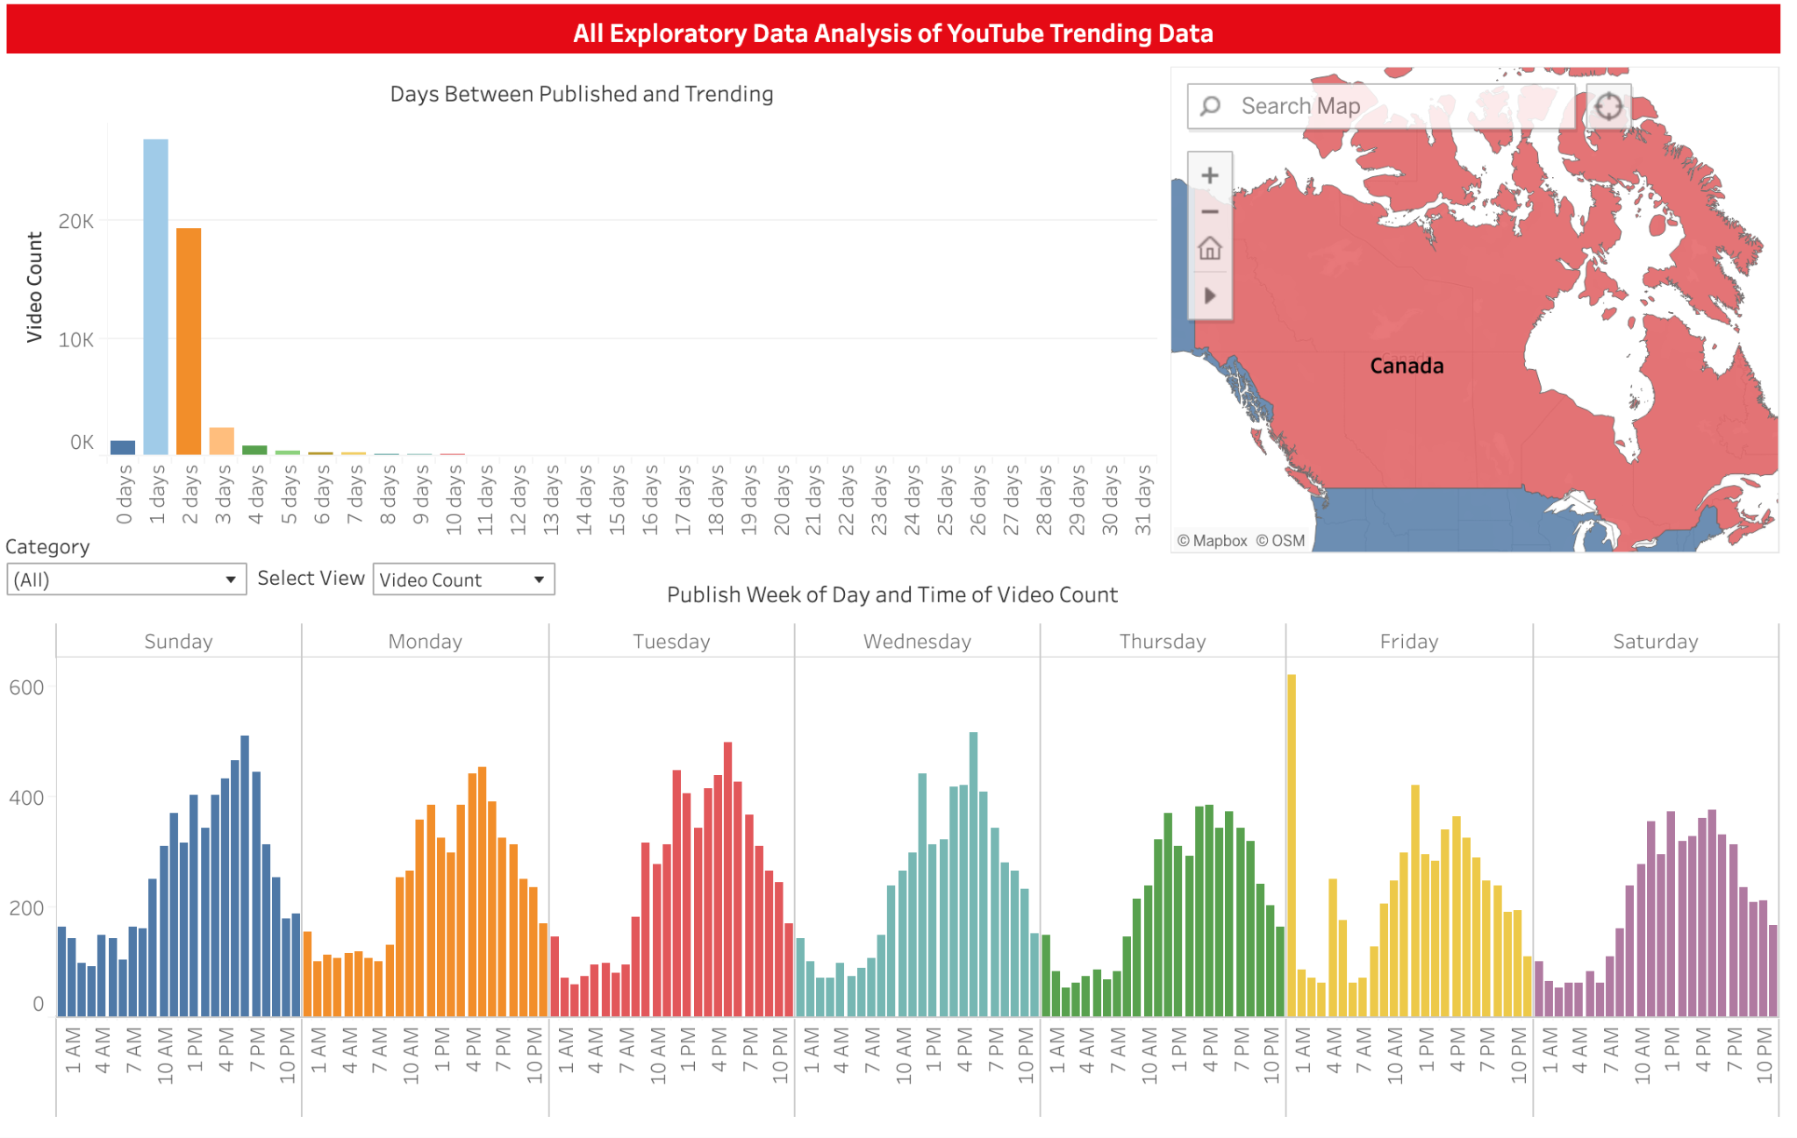
Exploratory Data Analysis
Notes:
From EDA, we can see the correlation of trending categories, likes, comments, views and publish date time.

Slide 6
Problem Statement
1
Publish date and time of trending videos
2
Cultural differences reflected in trending videos
3
Cultural similarities reflected in trending videos
Interactive Tableau Dashboards
Notes:
We propose three problems related to trending videos, and solve them in a comprehensive way with interactive Tableau dashboards.

Slide 7
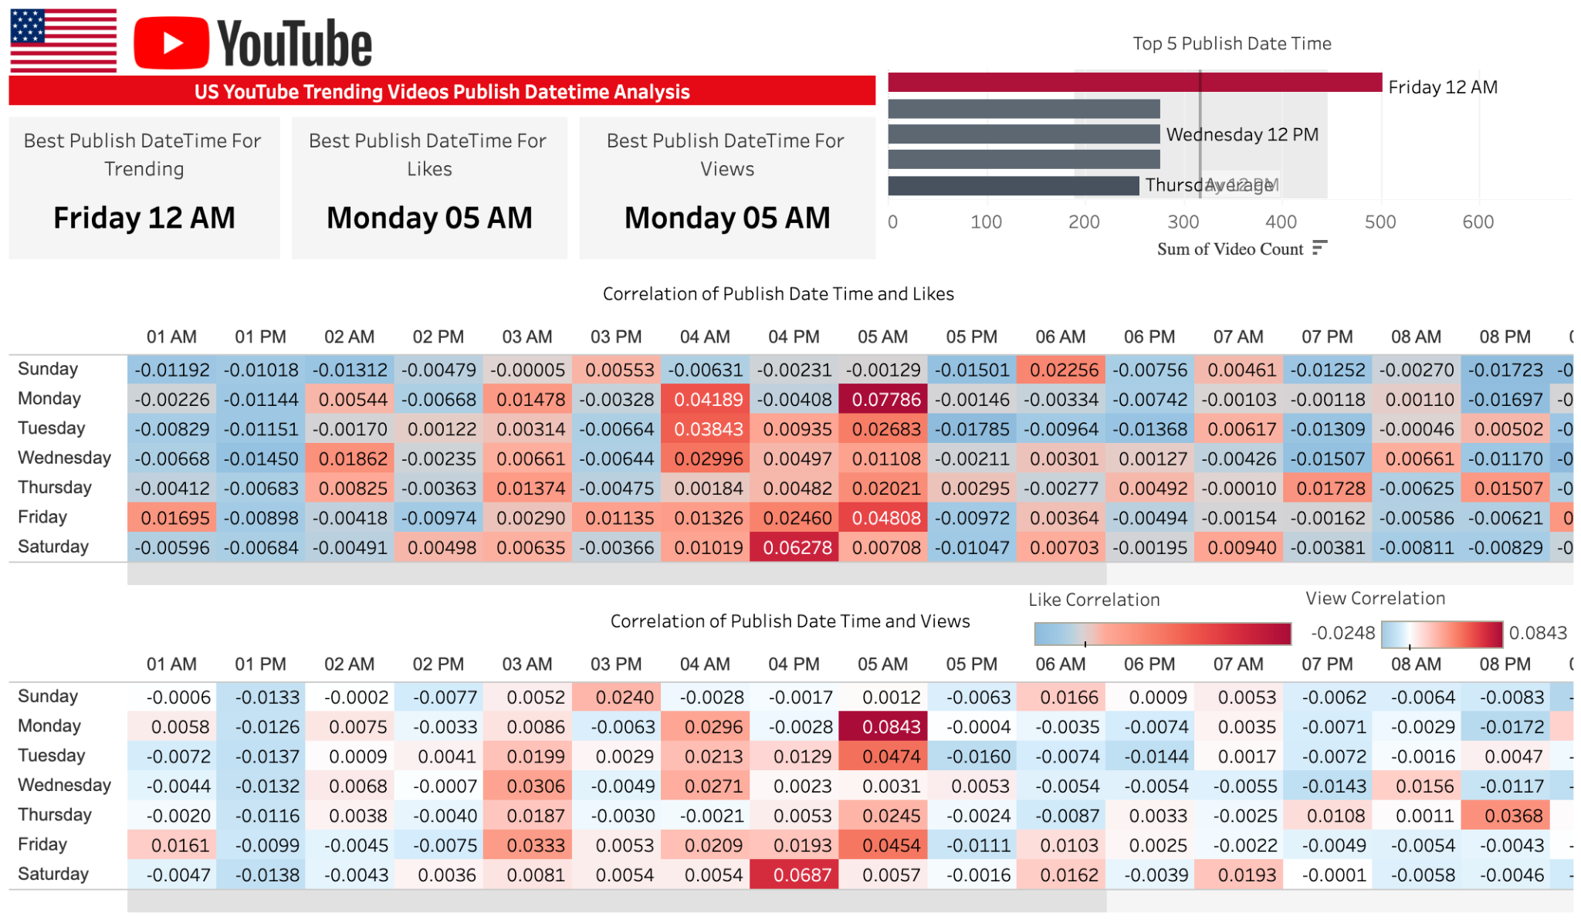
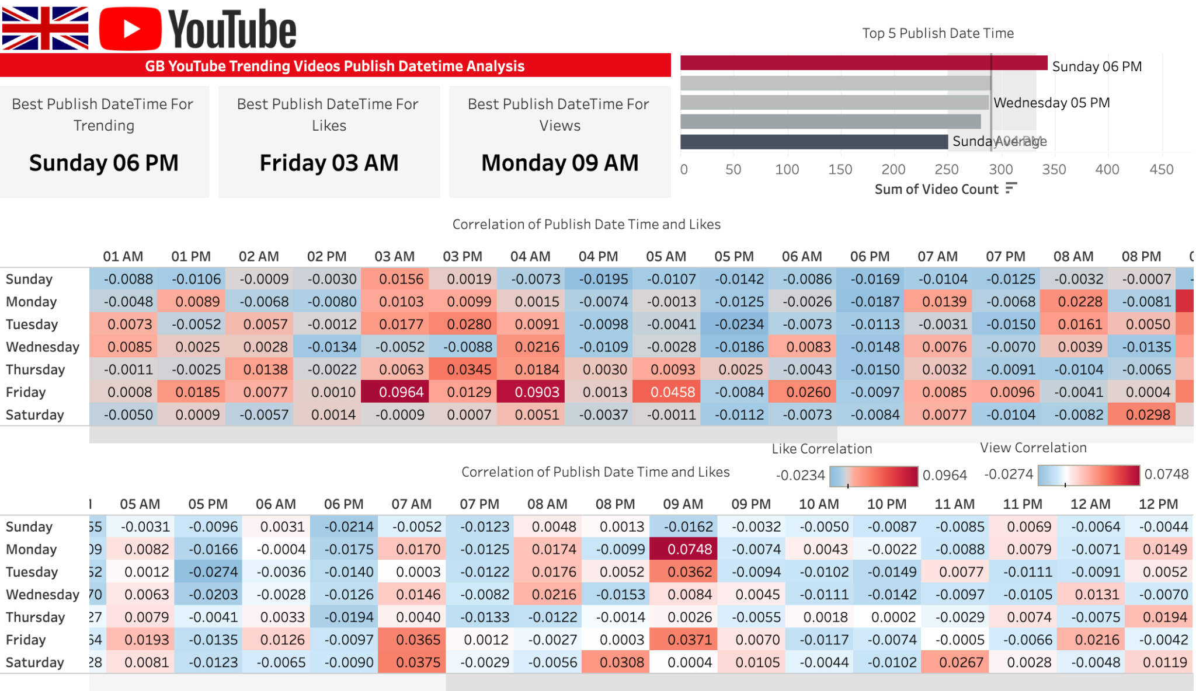
Problem Solving
1
Publish day and time of trending videos
vs. Trending
vs. Likes
vs. Views
Correlation of Publish Time
Notes:
We have found out that publish date time is important for video’s popularity and the channel should publish video by considering the targeted markets.
The best time publish time for US and UK are Friday 12 AM and Sunday 6PM respectively.

Slide 8
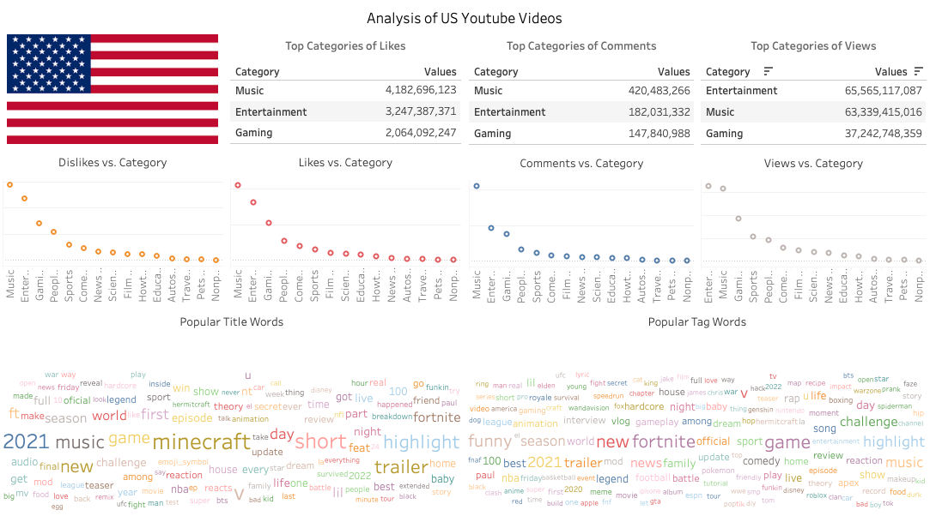
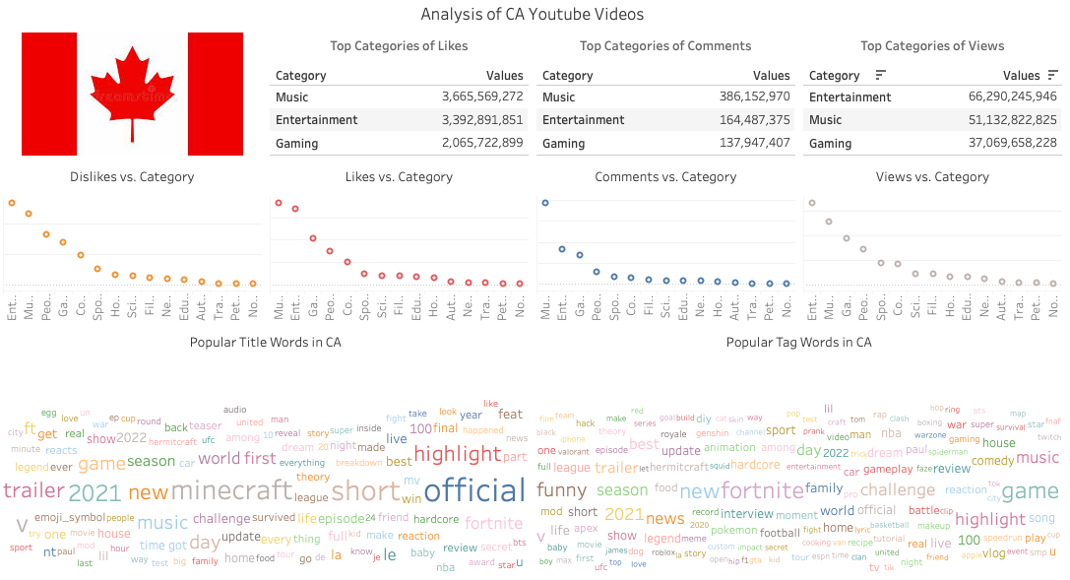
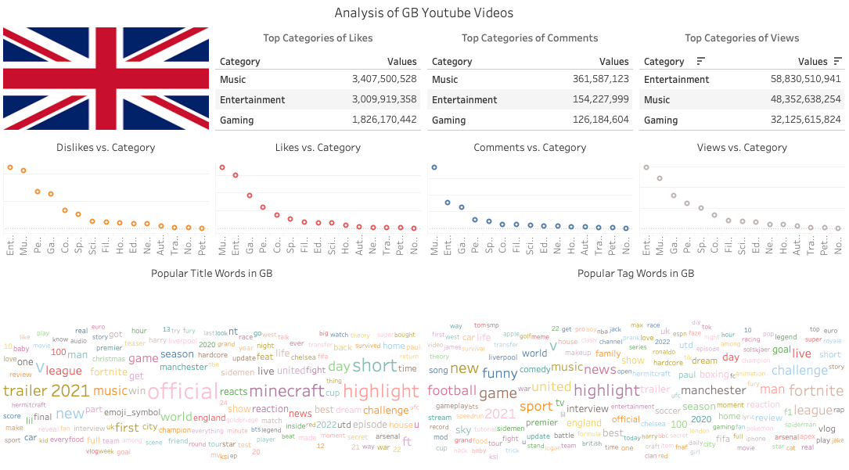
Problem Solving
2
Cultural differences reflected in trending videos
Media
Disney, Fox / Twitch / BBC
Person
Jake / Harry, Solskjær, Ronaldo
Sports
NBA, UFC, WWE / Chelsea, Manchester, Liverpool
Geographical
UK, euro, England
Holiday
Christmas
Episode
Spiderman / Squid Game
Notes:
Cultural differences embedded in titles and tags keywords are varies in some topics, especially geographics, media, and sports.
YouTubers who target at trending in a specific country can add corresponding keywords into titles and tags from different topics related to the video content.

Slide 9
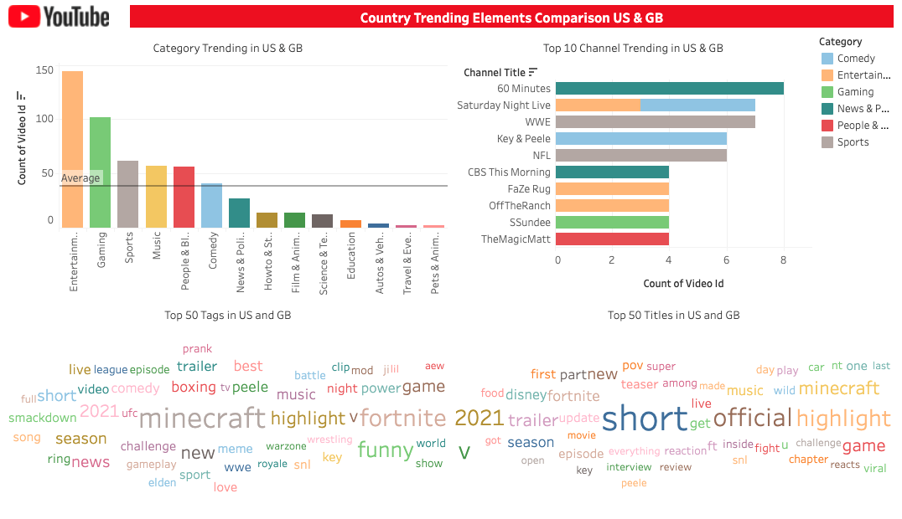
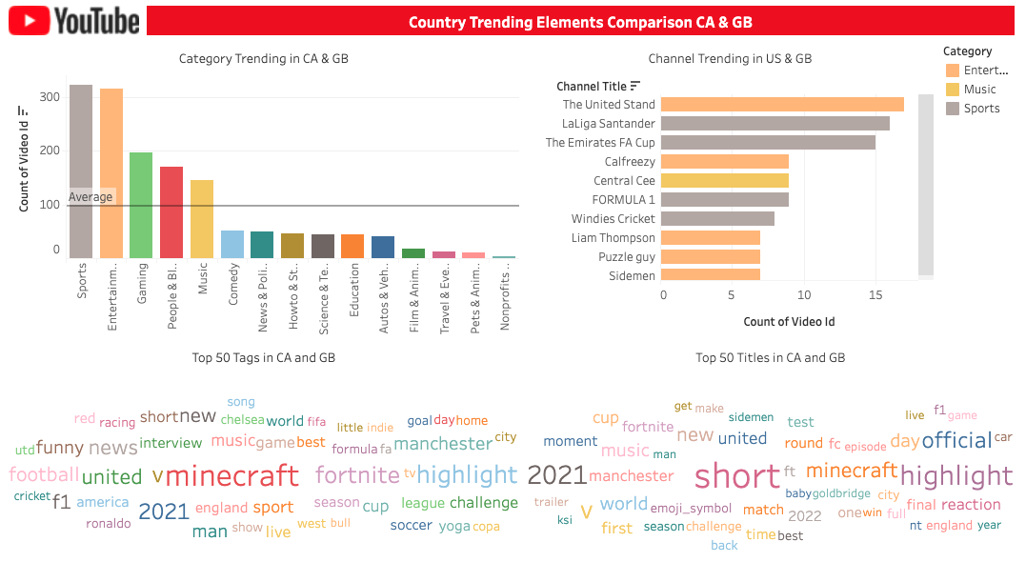
Problem Solving
3
Cultural similarity reflected in trending videos
Notes:
For cultural similarity analysis, comparing US & the UK, top trending channels vary. For Canada & the UK, their common interests focus on Entertainment, Music and Sports.

Slide 10
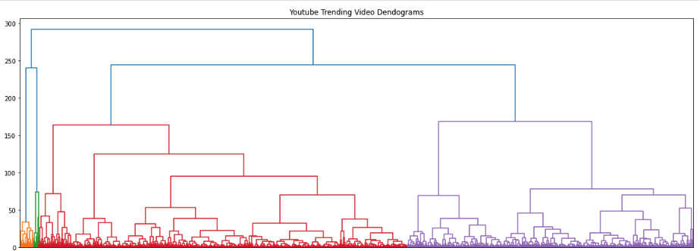
Machine Learning - Hierarchical Clustering
Dendrogram with Numerical/Categorical Features
View_count, likes, dislikes
Comment_count, pubToTreDays
Comments_disabled
ratings_disabled
Notes:
In the machine learning part, We first model with Hierarchical clustering.
From the dendrogram. there’s 4 different clusters. For the sake of finding sub-clusters inside of big ones, we cut the large clusters into smaller ones.

Slide 11
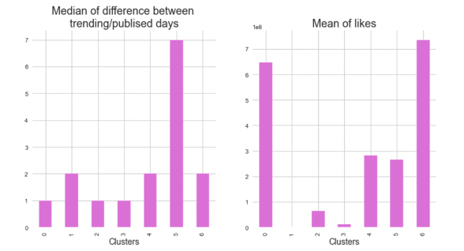
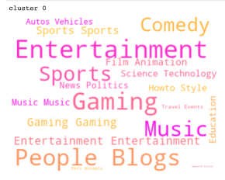
Machine Learning - Hierarchical Clustering
Dendrogram with Numerical/Categorical Features
Results ->
focus on 4 Categories:
View_count, likes, dislikes
Comment_count, pubToTreDays
Comments_disabled
ratings_disabled
Entertainment, Gaming, Music, Sports
Notes:
Both Cluster 0 and 6 trends rapidly and outperform others by winning high number of likes.
We explore the categories and in the next phase of finding, the scope is on 4 of them: Entertainment, Gaming, Music, Sports

Slide 12
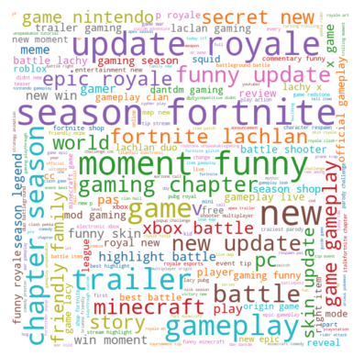
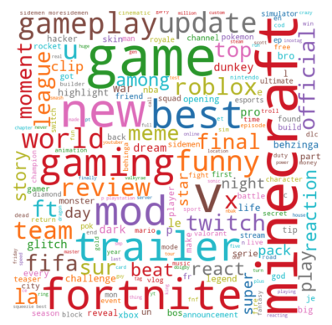
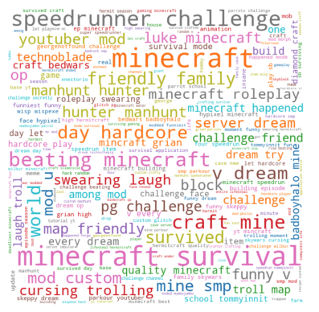
Machine Learning - KMeans
The Gaming Category
Tokenization
Lemmatization
Remove stopwords
Word embedding
Lowercase, remove urls, emojis, special characters
Words base form
caring -> care
Repeated but not useful words (tailored)
Word -> vector
Word2Vec
Notes:
The second model is kmeans with text data.
the data is preprocessed with steps such as tokenization, word embedding.
Due to limitation of time, the cluster result is only shown for the Gaming.
From the wordclouds, we can see that the first kind of videos focus on the game news such as trailer, season releasing, while the major players are Minecraft, Fortnite.
The second kind is featured by funny moment, highlight battle, or win moment.
The last attention is around techniques of game playing. The keywords are Minecraft survival, beating, challenge, dream try.

Slide 13
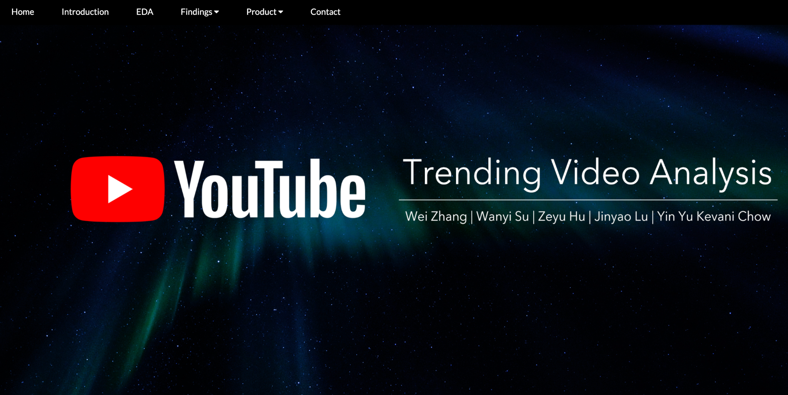
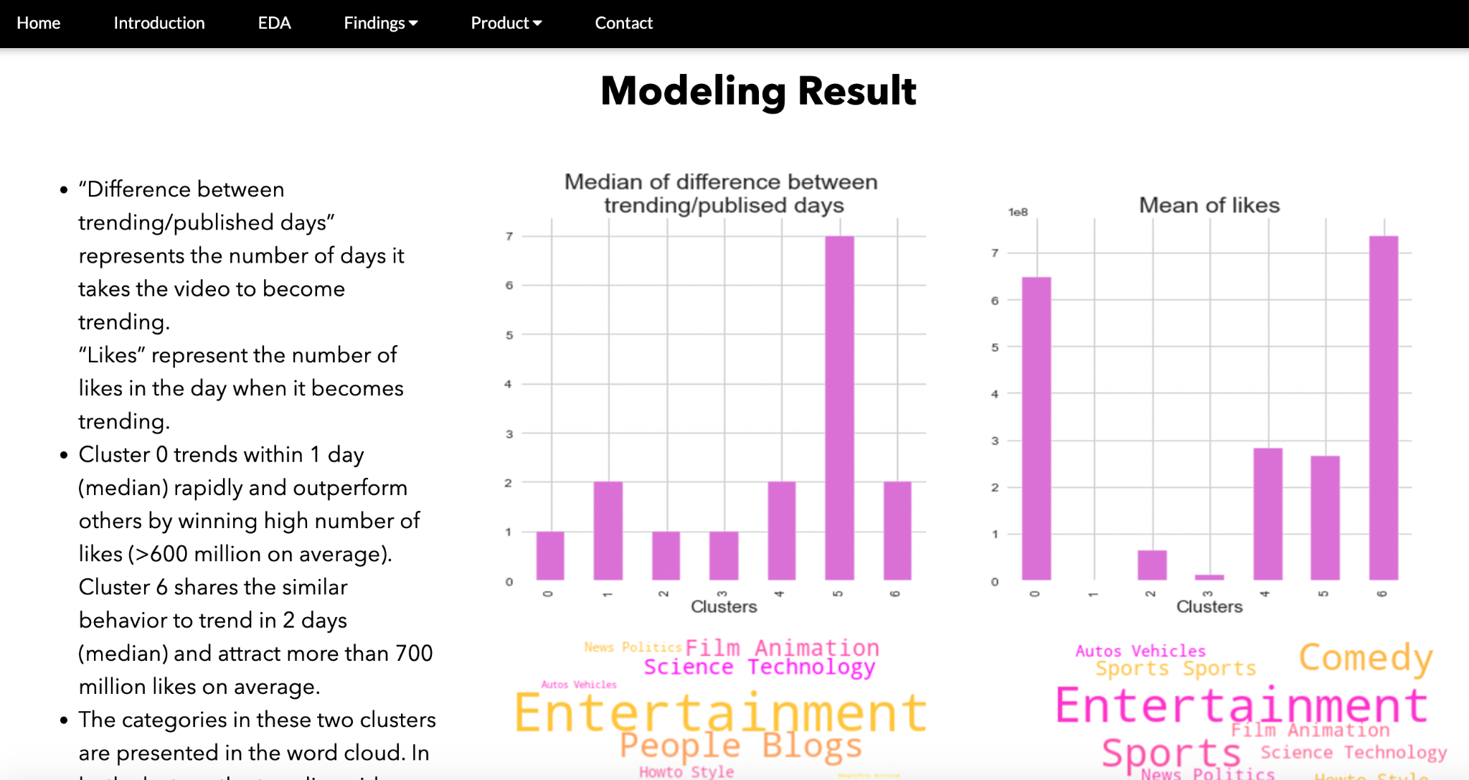
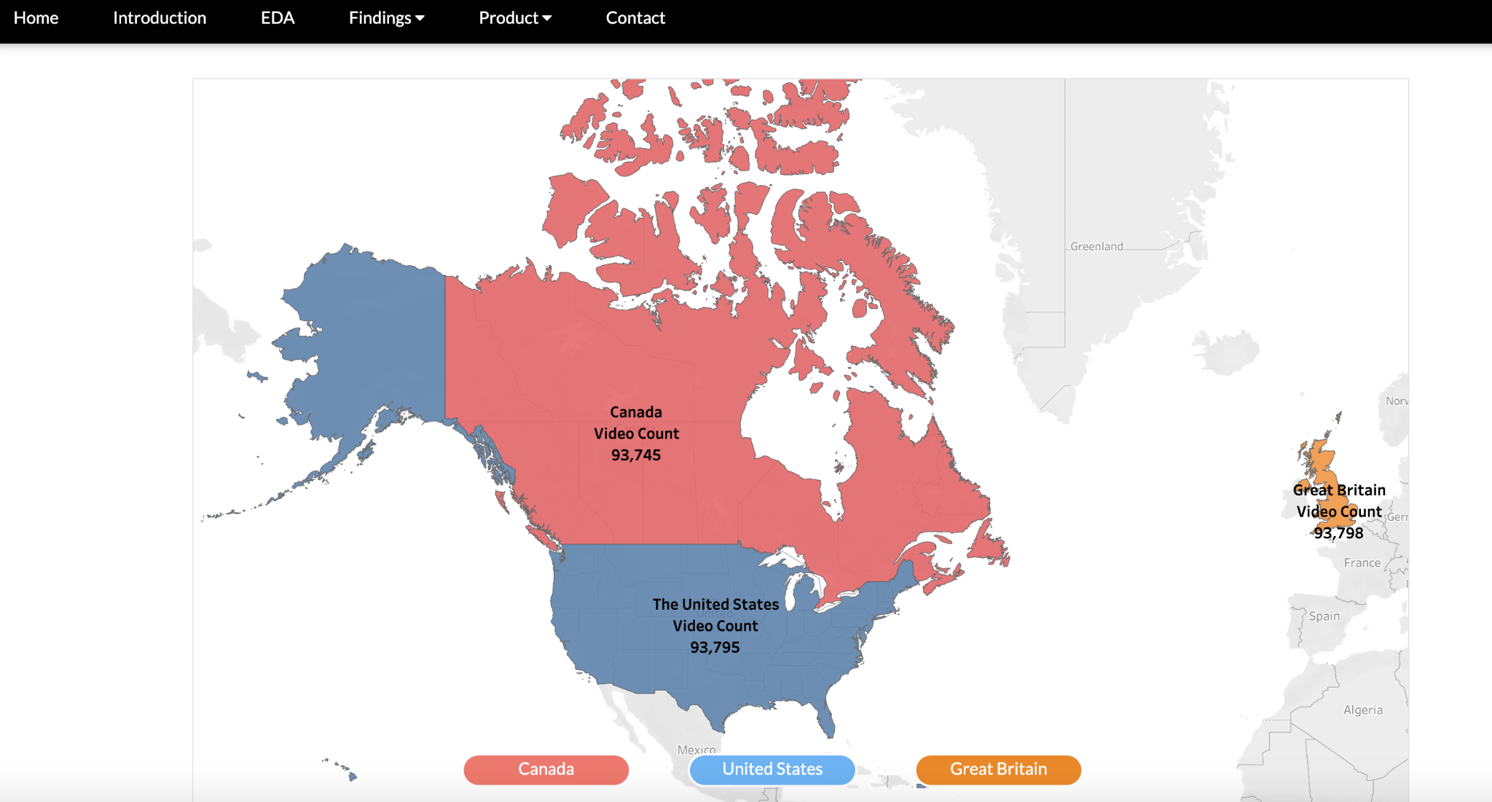
Website
Modeling Result
EDA
Link: https://yt-trending-video-analysis.herokuapp.com/
Notes:
Here are some screenshots of our website.

Slide 14
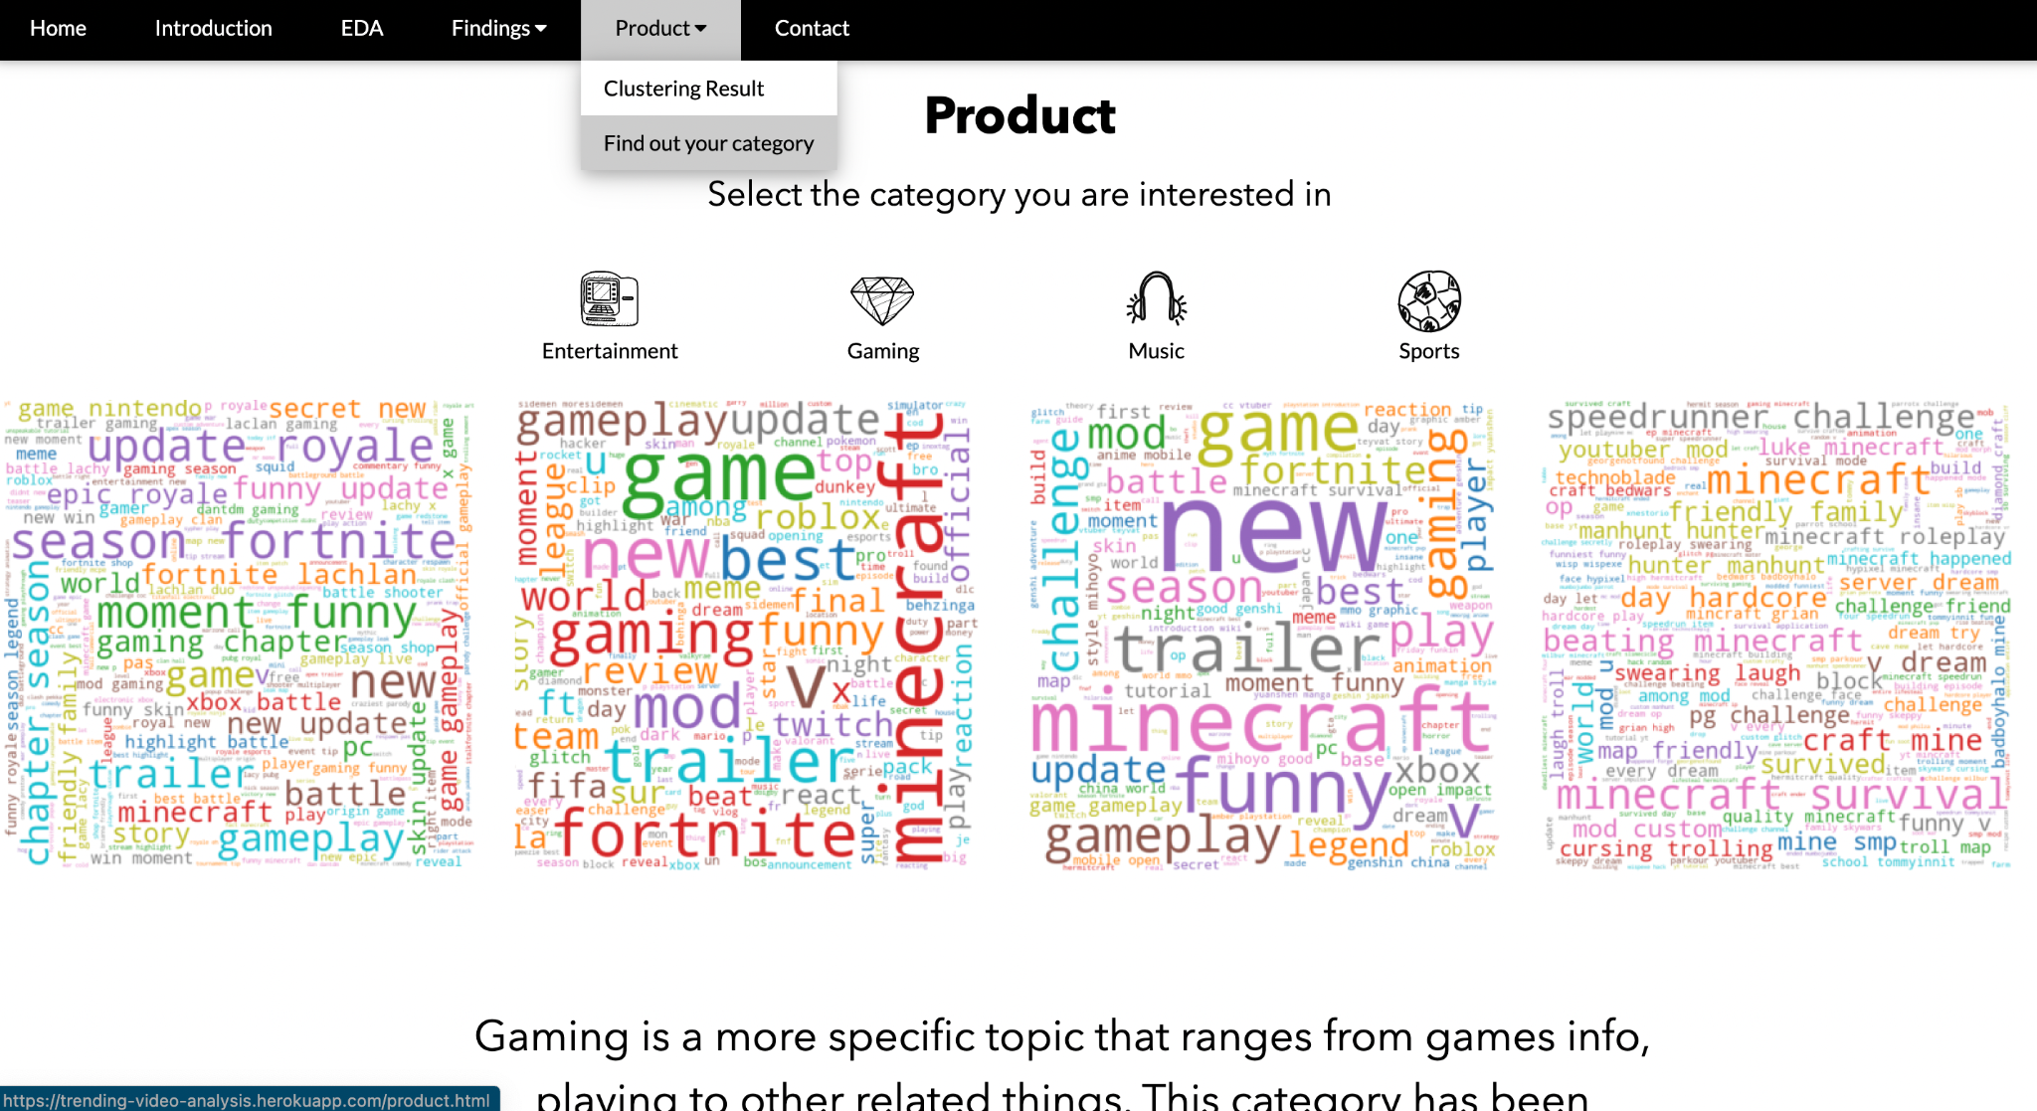
Data Product
Select a Category
WordCloud
Text Analysis
Relative Video link
Notes:
Our product offer suggestions to youtubers who wants to create hot videos. They will be able to choose categories of interest and view the analysis result. Here is our product demo.

Slide 15
Reflection And Future Work
Organize the scattered data into a more streamlined platform
More analysis on the thumbnail image
Ethical issues in videos analysis
In text mining, test and compare with stemming methods for preprocess
Break down big question into smaller ones
Add additional categories such as: Film & Animation, Autos & Vehicles, Pets & Animals
Notes:
There might be social and religious harassment content we might want to recognize.
For future work, we’ll focus on image analysis to explore the color combination and text to learn elements in trending videos.

Slide 16
Thank you!
Questions?
Github: https://github.com/yyc15/CMPT733_final_project
Notes:
Thank you for your time. We are now open to questions.

